Slide 1
Stock Price Prediction System
By Satya Ranjan Panda & Arnab Sarma

Slide 2
Contents
Definition of Stock Price Prediction System
Flow Diagram
System Requirements
Concept of the system
Result
Conclusion

Slide 3
Definition
A Stock Price Prediction System is a software or algorithm that utilizes various statistical and machine learning techniques to analyze historical stock market data, identify patterns and trends, and forecast future stock prices. The system typically takes into account various factors that affect stock prices, such as company financials, market trends, news and events, and economic indicators.
The goal of a Stock Price Prediction System is to help investors and traders make more informed decisions about buying, selling or holding stocks by providing them with insights into future market trends and stock price movements. The system can be used for both short-term and long-term stock price predictions and can be applied to individual stocks, sectors, or the overall stock market.
Overall, a Stock Price Prediction System is a valuable tool for investors and traders who are looking to improve their investment decisions and maximize their returns.

Slide 4
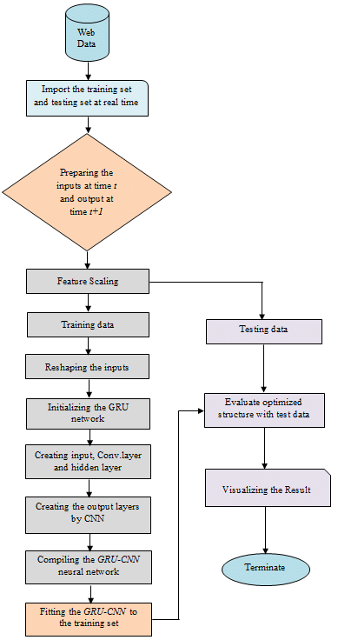
flow diagram

Slide 5
System requirements
Hardware Requirements :
Ram 2GB
STORAGE 1GB
32 OR 64 BIT SYSTEM
SOFTWARE REQUIREMENTS :
PYTHON 3.5 OR HIGHER
VS Code
Git & GitHub
Jupyter Notebook

Slide 6
Concept of the system
Use YFinance to download historical stock market data for a particular company or market index.
Preprocess the data by cleaning, normalizing, and transforming it into features that can be used to train your machine learning model.
Use Keras and TensorFlow to build and train your machine learning model using the preprocessed data.
Test the performance of your machine learning model using a validation set or a test set of data.
Use Dash to create an interactive dashboard that displays the predictions made by your machine learning model in real-time.

Slide 7
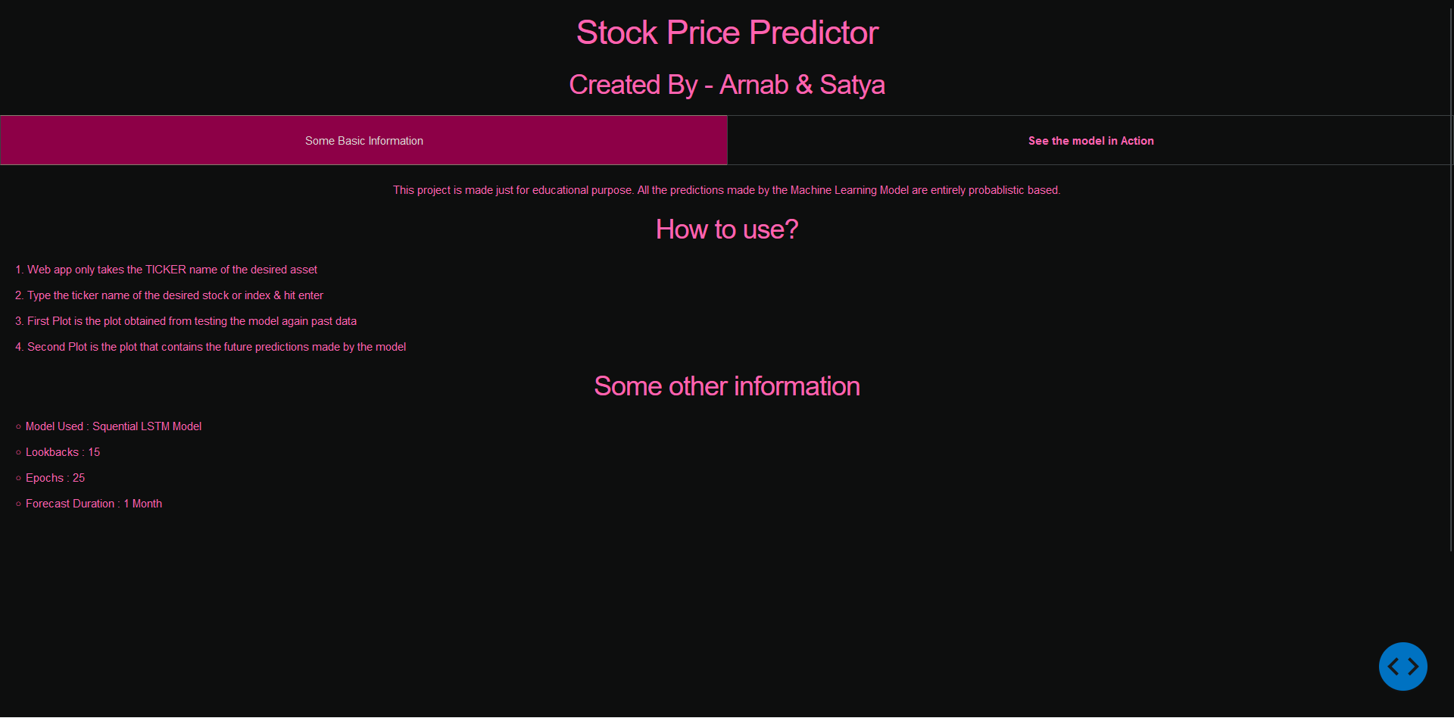
Result

Slide 8
Conclusion and limitation
In conclusion, the Python script we examined provides a practical example of how to use several key data processing and analysis libraries to extract insights from a dataset. By utilizing the NumPy, Pandas, and Matplotlib libraries, the script demonstrates how to perform basic data manipulations and visualizations, such as sorting, filtering, and plotting. The functions defined in the script are modular and reusable, making it easy to apply these techniques to other datasets with similar structures. However, it's worth noting that the script has some limitations. Firstly, the analysis presented in the script is relatively basic, and more complex techniques may be required for larger, more complex datasets. Additionally, the script assumes that the data is already clean and organized, which may not always be the case. Pre-processing steps may be necessary to clean and prepare the data before conducting any analysis. Overall, this script serves as a useful starting point for anyone looking to analyse data using Python. By building upon the techniques and functions presented in this script, researchers and analysts can create more advanced analyses that yield meaningful insights.

Slide 9
Thank you

